Slide 1

Customer Retention
9th June,2022
Internship-27
Presented by:
Someshwar Dipak

Slide 2
Acknowledgement
Data Science with ML
SME - Swati Mahaseth
Flip Robo Technology

Slide 3
What is Customer Retention?
Customer retention is a metric that measures customer loyalty, or the ability for an organization to keep its customers over time.
In addition to identifying the number of loyal customers, customer retention can reflect or predict customer satisfaction, repurchase behavior, customer engagement and emotional ties to a brand.
A comprehensive review of the literature, theories and models have been carried out to propose the models for customer activation and customer retention.
The goal of customer retention programs is to help companies retain as many customers as possible, often through customer loyalty and brand loyalty initiatives.
It is important to remember that customer retention begins with the first contact a customer has with a company and continues throughout the entire lifetime of the relationship.

Slide 4
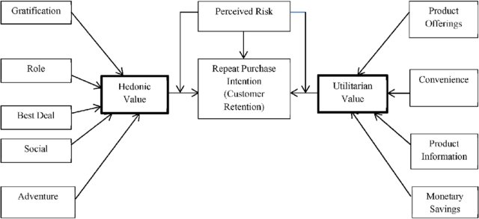
Customer Retention Diagram:

Slide 5
Visualization of Customer Retention

Slide 6
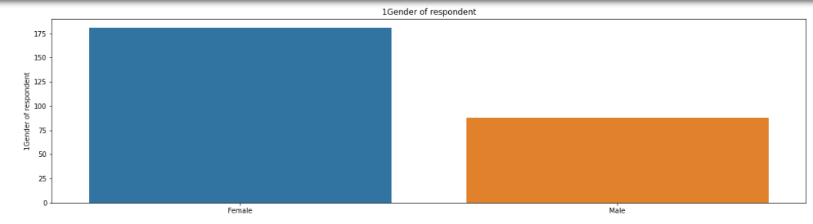
Graphs:
This barplot gives numbers of counts and showing that which gender is more interesting to purchase products from online stores.
From this barplot we analysis that female counts are more than male counts for purchase product from online store.

Slide 7
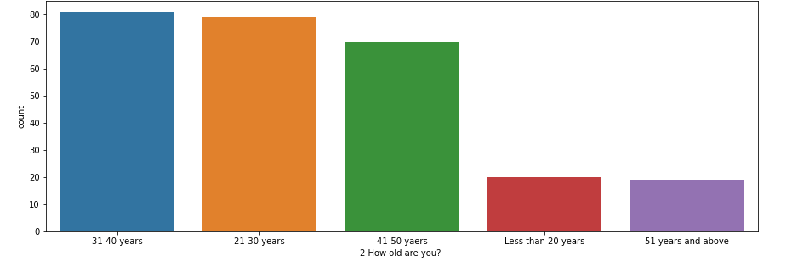
Graphs:
This countplot gives numbers of counts and showing that which age is more interesting to purchase products from online stores.
From this barplot we analysis that 21-30 and 31-40 younger age are more interested to purchase product than others.
Less than 20 and above 51 age counts are very low.

Slide 8
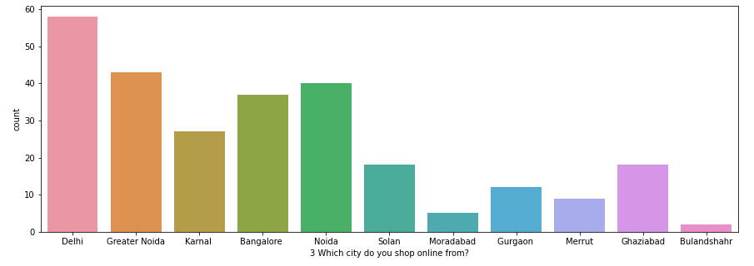
Graphs:
This countplot gives numbers of counts and showing that which city is more to purchase products from online stores.
From this barplot we analysis that Delhi, Greater Noida and Bangalore are more interested to purchase product than others because of they are mega city.
Other cities are less interested to purchase product from online store.

Slide 9
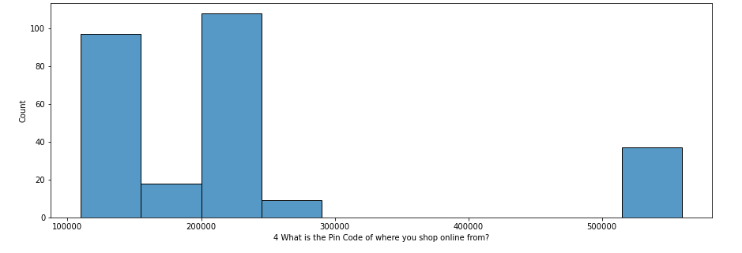
Graphs:
This histogram plot gives numbers of counts and showing that which city pin codes are more to purchase products from online stores.
From this histplot we analysis that between 100000 to 1500000 and 200000 to 250000 are more interested to purchase product than others.

Slide 10
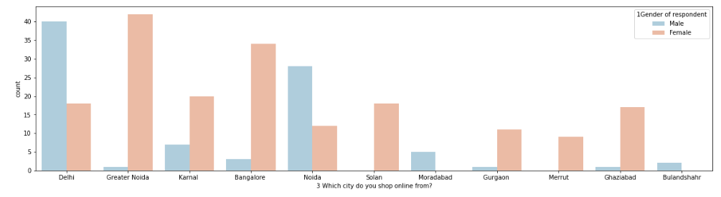
Graphs:
This countplot gives numbers of counts and showing that which gender are more from different cities to purchase products from online stores.
From this countplot we analysis that female counts are more interested to purchase product than male from different cities except delhi and noida.

Slide 11
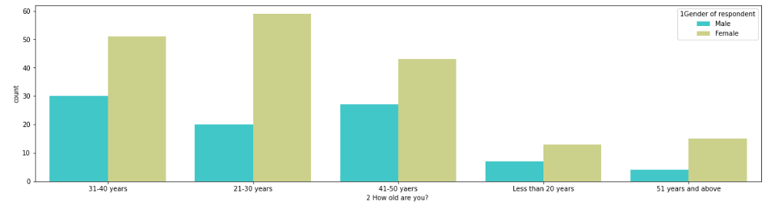
Graphs:
This countplot gives numbers of counts and showing that which gender are more from different ages to purchase products from online stores.
From this countplot we analysis that female counts are more interested to purchase product than male from different ages.

Slide 12
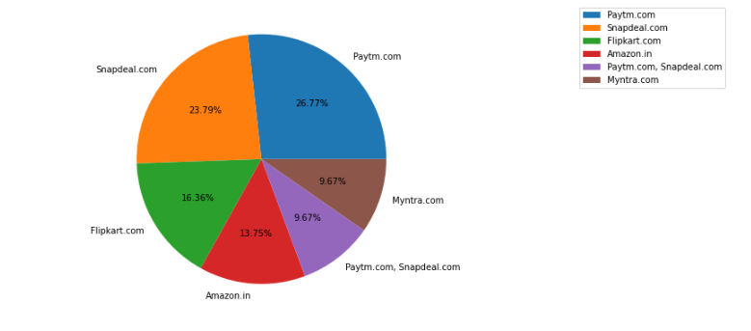
Graphs:
This pie chart gives percentage and showing that which e-commerce has longer delivery period.
From this pie chart we analysis that Paytm and Snapdeal has longer delivery period. Flipkart, Amazon and Myntra’s delivery period has less.

Slide 13
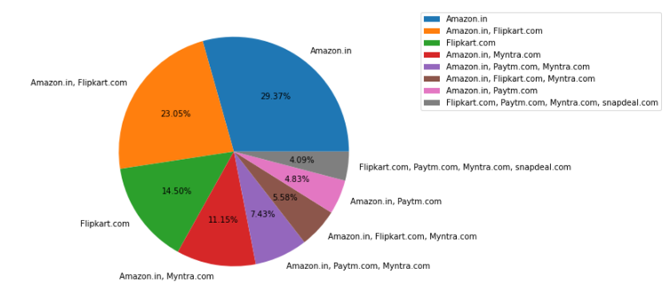
Graphs:
This pie chart gives percentage and showing that which Indian online retailer recommend to a friend.
From this pie chart we analysis that Amazon and Flipkart are recommend because of their delivery speed, reliability trustworthy in customer privacy, security, wild variety of product, user friendly content and graphics etc.

Slide 14
Conclusion :
As per visualization and analysis Amazon and Flipkart are best Indian online retailer to recommend as a friend because of delivery speed, reliability trustworthy in customer privacy, security, wild variety of product, user friendly content and graphics etc.

